Slide 1

ANALYSIS OF DEMAND RESPONSE BASED ON LOAD MODEL IN THE FRAMEWORK OF DEEP LEARNING
Abakar Mahamat HASSAN, Ziyodulla YUSUPOV
Karabuk University, Electrical and Electronics Engineering, Karabuk, Türkiye

Slide 2
CONTENTS
Introduction
Methodology
DR programs classifications
Current Challenges in DR
Advantages and disadvantages
Deep Learning Algorithms in Demand
Demand Response Architecture
Conclusion
Q&R and thanks
1/13

Slide 3
Introduction
As smart grid technology continues to develop, demand response (DR) stands out as a transformative and adaptive approach in Microgrid, as known in Microgrid (PV and Wind) energy production depends on the weather, so the load demand fluctuates every hour, and to keep the customers actively participate in demand response there are two types of programs that can be used in Demand Response, these programs are Price-based DR and Incentive-based .
2/13

Slide 4
Methodology
Through a systematic methodology encompassing difference research from a difference Engineering conferences papers, journals papers, and etc, this paper was prepared to throught these researches was clarified that demand response combinations are formed from technological, behavioural, and policy-driven approaches to curtail electricity usage during peak demand times.
3/13

Slide 5
DR programs classifications
4/13

Slide 6
Current Challenges in DR
The challenges bellow considered with a real-time demand response program including
Time delays
Uncertainties
Characterization errors
Multiple timescales
And nonlinearity
5/13

Slide 7
Advantages and disadvantages
Advantages:
Grid Integration and Stabilization
Increase power system flexibility
Provided flexibility can be used to meet the fluctuations of renewable generation
Reducing the system cost and increasing economic efficiency
User Flexibility and Control
Cost Savings
Environmental Benefits
6/13

Slide 8
Cont.
II. Disadvantages
Unriliable participation
Complexity
Grid dependency
Data Privacy and Security
7/13

Slide 9
Deep Learning Algorithms in Demand Response
Recurrent Neural Networks (RNNs) and Long Short-Term Memory (LSTMs): networks are effective in modelling time-series data which is crucial in predicting energy consumption patterns
Convolutional Neural Networks (CNNs): can be used to identify patterns in energy usage data, contributing to the detection of peak demand periods and the formulation of corresponding DR strategies
Reinforcement Learning: particularly deep reinforcement learning algorithms learn optimal policies to balance energy demand and adapting to changing grid conditions and user behaviour
8/13

Slide 10
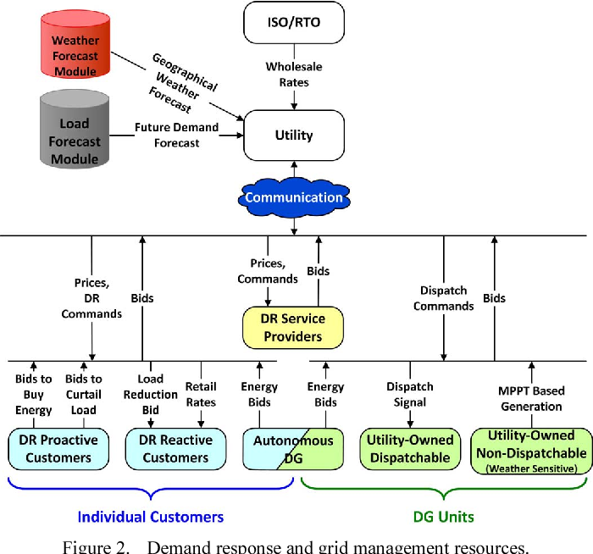
Demand Response Architecture
These figure shows the architecture of Demand Response in Microgrid and Deep Learning.
Microgrid DR Architecture
9/13

Slide 11
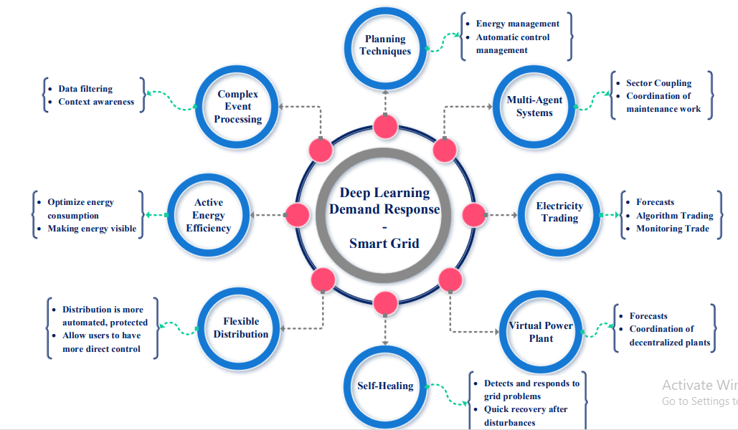
Cont.
Deep Learning DR Architecture
10/13

Slide 12
Conclusion
The exploration of deep learning algorithms and advanced technologies in the realm of demand response has illustrated a significant potential to revolutionize how energy systems are managed and optimized. It signifies a crucial advancement towards establishing a more intelligent, environmentally friendly, and robust energy infrastructure. by using the deep learning in the field of electricity and especially in DR, in the future development can make a significant change in Advanced Grid Resilience with AI, Personalized Demand Response and Regulatory Evolution.
11/13

Slide 13

Q&R and thanks
Electricity is the best discovery and smart grid is the best chose to use it.
12/13

Slide 14

13/13

